Slide 1
25Live Scheduling System Enhancements
Notes:
Updated 8-18-15, 2015

Slide 2
25Live Enhancement Project
25Live Key Users Group Overview
Comprised of a representative group of key stakeholders whose intention is to continually examine and improve the functional use and business processes related to all aspects of the Series25 implementation. Series25 includes the main 25Live event scheduling system and all of its related components (i.e. calendaring, ticketing, accounting, automated classroom scheduling, etc.).
This group seeks to:
Continuously improve scheduling and event related processes and reporting.
Continually improve communication methods between stakeholders and out to the campus.
Coordinate both vendor delivered system upgrades and new functional implementations.
Develop and deploy system training as needed.
Ensure critical informational updates are reflected in the system (i.e., room features, furniture and capacities).

Slide 3
25Live Enhancement Project
Primary Goal – Ease and Simplicity
Clean and Simple Default Interface
Improved One Page Request Form
Meaningful Event Types
Easier Service Requests

Slide 4
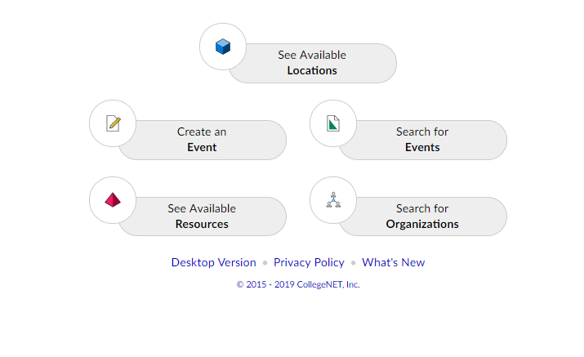
25Live Enhancement Project
Clean Simple Interface
Most requestors don’t need everything
Take advantage of simplified interface – developed for “mobile”

Slide 5
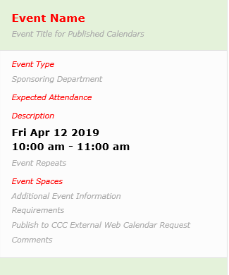
25Live Enhancement Project
One-Page Request Form
No more clicking through multiple pages to submit a simple meeting request

Slide 6
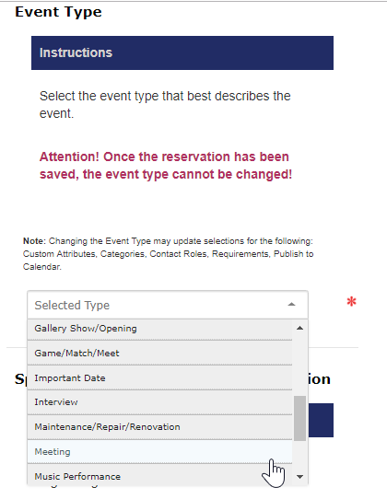
25Live Enhancement Project
New Event Types
No need to declare if it is a staff, student or external event; or the campus
Select what type of event you are actually putting together
Set us up for future capabilities:
Ask for different info for different types of events
Improve event searches, calendaring and reporting

Slide 7
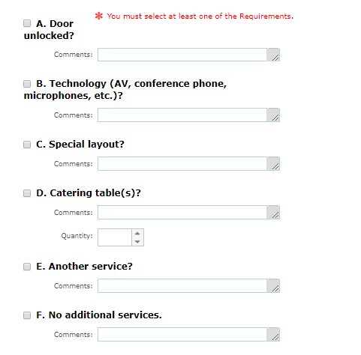
25Live Enhancement Project
Required Services
Easier to request other services

Slide 8
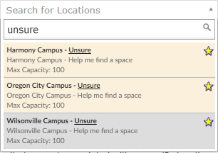
25Live Enhancement Project
Several Other Smaller Enhancements
Revision of Event Wizard Request Form Instructions
Took advantage of key users to determine instruction text that makes more sense
“Unsure” Spaces
Ability to get help finding spaces by campus
Required to select a space

Slide 9
25Live Enhancement Project
Helping With Change
Same Basic Functionality
Same portal link location - adjusted to new interface
General functionality is same
Ability to flip back to original interface with a click
Help Is Available
New resource web page being deployed next to link
Two Pre-Launch Trainings
Two Post-Launch Trainings
Harmony Trainings To Be Determined
Support Email: 25LiveSupport@clackamas.edu

Slide 10
25Live Enhancement Project
Key Dates
Pre-Launch Trainings
5/1/19 3-4:00PM (M132)
5/2/19 9-10:00AM (M132)
Production Launch Date
5/10/2019
Post-Launch Trainings
5/15/19 8:30-9:30AM (M132)
5/16/19 3-4:00PM (M130)

